Slide 1
OPIM 5604 – Predictive modeling PREDICTING RUSSIAN HOUSE PRICES
Team Members:
Aditya Nagori
Arijit Sinha
Rishitha Gajjala
Sai Gayatri Narne
1

Slide 2
Agenda
Problem Statement
Data Availability (Data Set & Inputs)
Exploratory Data Analysis
Data Pre-Processing
Data Modeling
Insights
Enhancements

Slide 3
Problem Statement
Sberbank helps its customers predict realty house prices
To develop a model that accurately determines the housing prices in Russia
Key Objective
To help Sberbank provide more certainty to their customers in an uncertain economy.
3

Slide 4
Importance of predicting housing prices
Housing
Biggest Investment
High risk
Higher Wealth Impact
4

Slide 5
Agenda
Problem Statement
Data Availability (Data Set & Inputs)
Exploratory Data Analysis
Data Pre-Processing
Data Modeling
Insights
Enhancements

Slide 6
DATA AVAILABILITY
Data Availability
Original Dataset
292 Predictors
12 predictors
280 predictors
30472 observations
Internal housing features
Supporting information
6

Slide 7
Agenda
Problem Statement
Data Availability (Data Set & Inputs)
Exploratory Data Analysis
Data Pre-Processing
Data Modeling
Insights
Enhancements

Slide 8
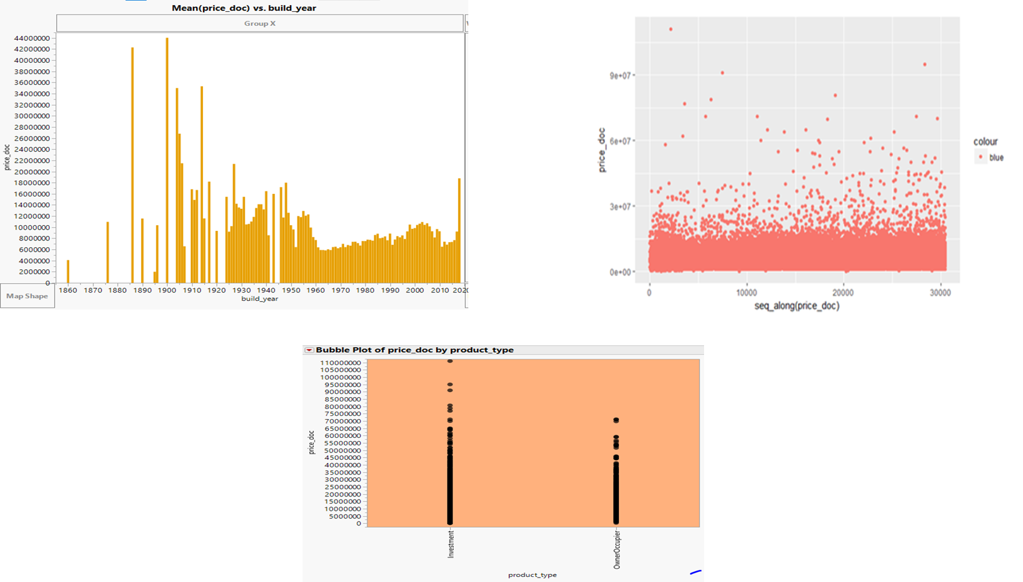
DATA AVAILABILITY
Exploratory data analysis
8

Slide 9
Agenda
Problem Statement
Data Availability (Data Set & Inputs)
Exploratory Data Analysis
Data Pre-Processing
Data Modeling
Insights
Enhancements

Slide 10


Data pre-processing
Data Cleaning
We removed observations and brought them down to nearly ~16K
For many columns such as build year, hospital beds raion etc. many rows have NA values
Imputed some inconsistent values in columns such as State, Build year
Calculated the Mahalanobis distance for each observation and removed the observations with z scores >3 and <-3
Data Modification
Binned the sub area variable into 5 region categories
The sub area variable had ~150 locality names which we searched on google
Found in which part of Russia that location exist
Created 5 different region codes ex. North, South, East, West, Centre
10

Slide 11
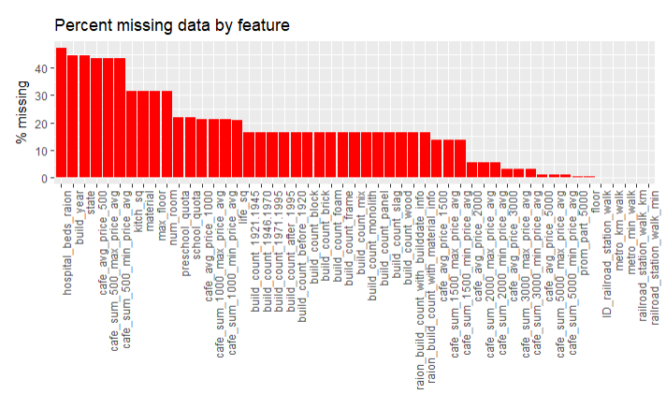
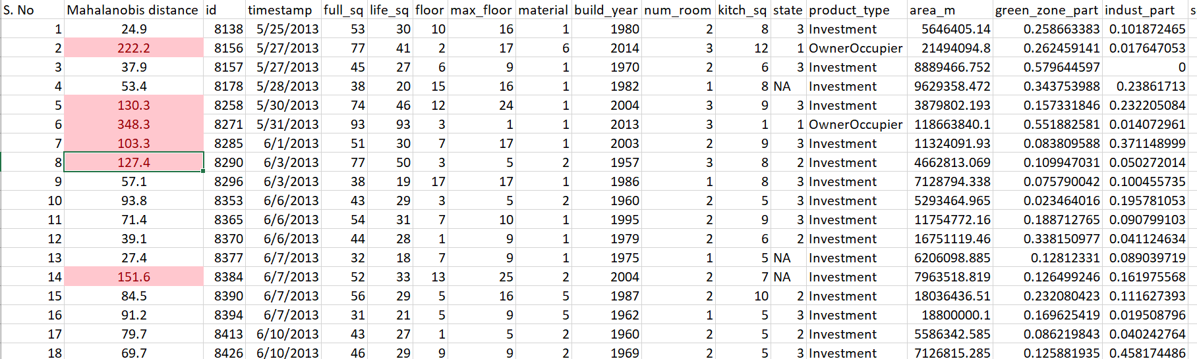
Data Cleaning
Few of the columns have about half of the rows having NA values
Added a column of Mahalanobis distance for each observation and removed the outliers
11

Slide 12
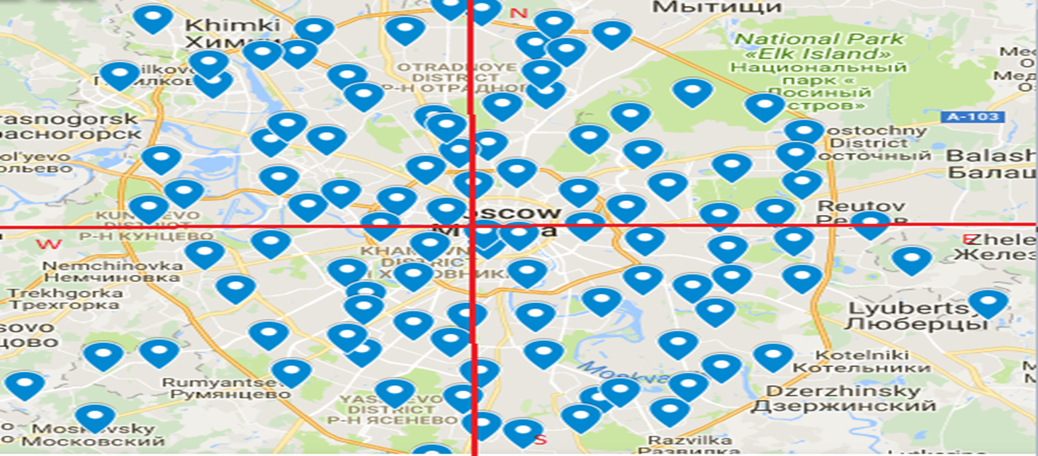
Data Modification
Google maps screenshot of all the sub area locations in Russia
Created 5 different region codes ex. North, South, East, West, Centre
12

Slide 13


Data pre-processing
Data Normalization
We normalized the data as per the need
Changed the scale of output variable (price)
For unsupervised learning techniques such as PCA or some of the advanced machine learning algorithms (ex. SVM) we normalized the independent variables to remove unwanted bias
Data Reduction
Reduced the number of original predictors (290) to 56
Created the correlation matrix for all the variables
Found the VIF values for all the independent variables
On the basis of above two points and business understanding, EDA conducted, p values obtained after running the regression model and important variables getting used in tree splits
13

Slide 14
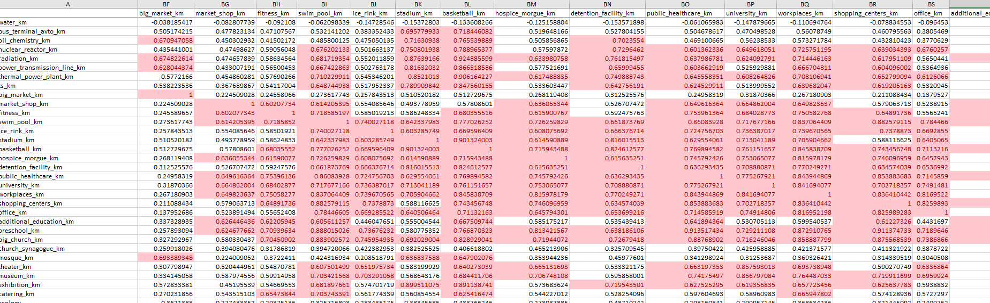
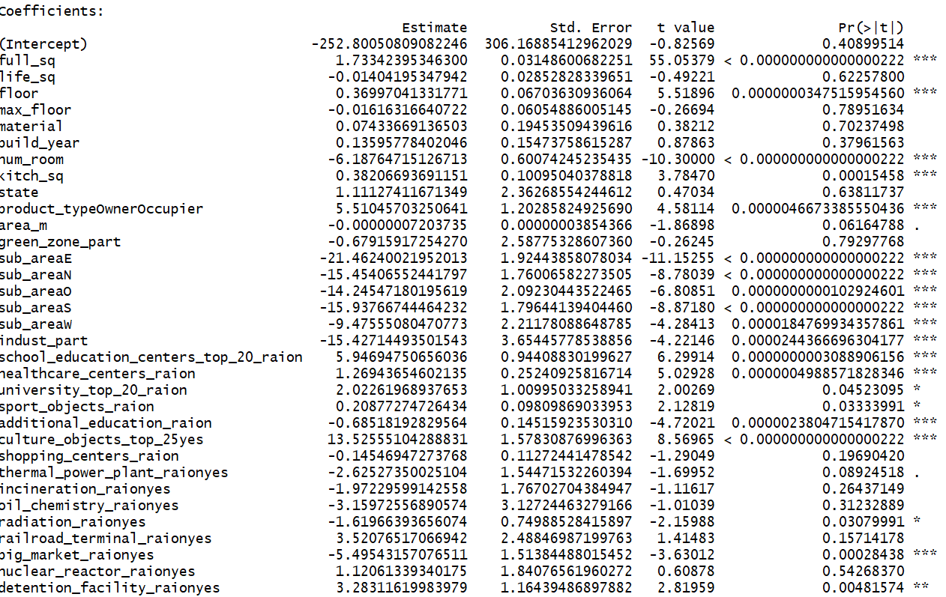
Data Reduction
Excel screenshot of a section of correlation matrix
P values obtained after running the regression model
14

Slide 15
Agenda
Problem Statement
Data Availability (Data Set & Inputs)
Exploratory Data Analysis
Data Pre-Processing
Data Modelling
Insights
Enhancements

Slide 16
Data Modelling
MODELS CREATED
Multiple Linear Regression (with and without interactions)
LASSO (Least absolute shrinkage and selection operator)
PCA (Principal component analysis)
Decision Tree
Random Forest
Boosted Tree
Support vector machine
16

Slide 17
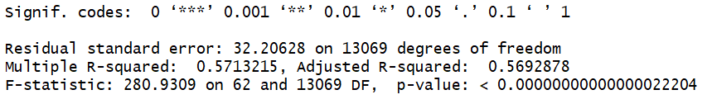
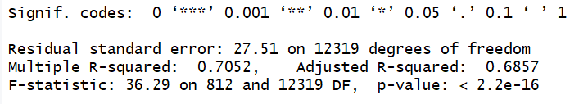
Data Modelling
MULTIPLE LINEAR REGRESSION
All the possible two-way interaction terms of each numerical variables with each categorical variable
Set | R Squared Without interactions | R Squared With interactions
Training | ~57% | ~70%
Test | ~42% | ~43%
The training test split ratio was kept at 80:20 and the test set was kept same throughout to enable model comparisons
Key Points:
Low model fitness
High difference in training R squared value in models with and without interaction
Similar results for the two models on test set indicating model has over-fitted
Need to compare with other non linear models
17

Slide 18
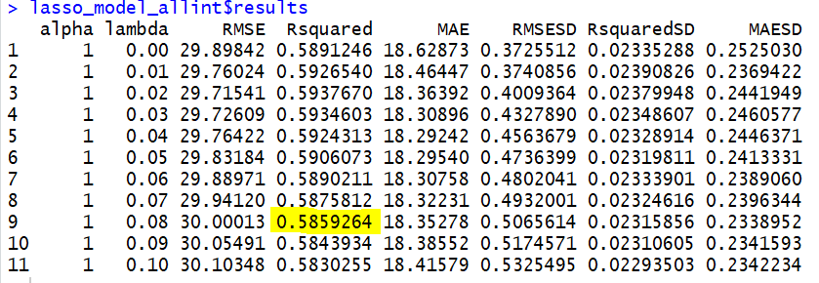
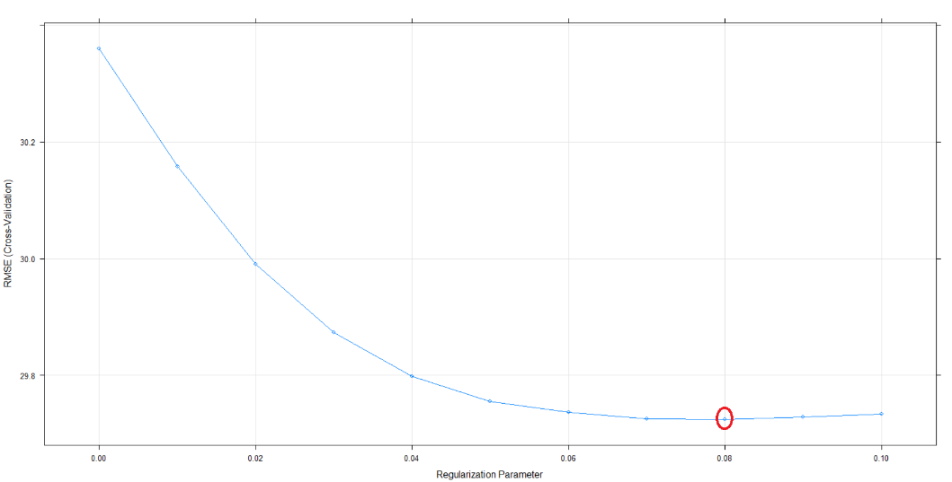
Data Modelling
LASSO
RMSE (Cross-Validation)
Regularization Parameter
3 fold cross validation approach using CARET package in R
Key Points:
Improved model performance from normal regression
The right graph above shows RMSE against different tuning parameters, lambda which automatically ‘de-emphasize’ variables that are not important
18

Slide 19
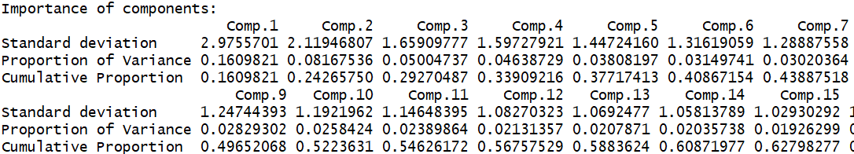
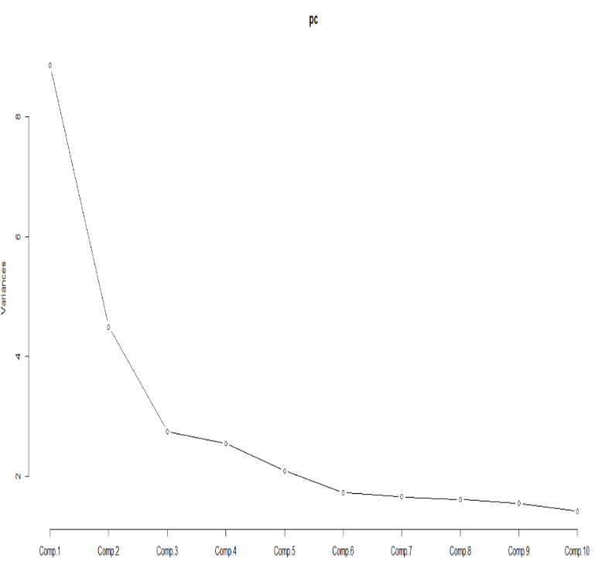
Data Modelling
Principal Component Analysis (PCA)
Variances
Key Points:
Looking at the scree plot, after the 6th PCA, the other PCA’s does not contribute significantly in explaining dataset variance
The cumulative variance explained by the first 6 PCA’s is also ~40%
Also, we ran regression using the first 10 PCA’s and the results were quite similar
Thus, the PCA technique is not very helpful for our dataset in model creation
19

Slide 20
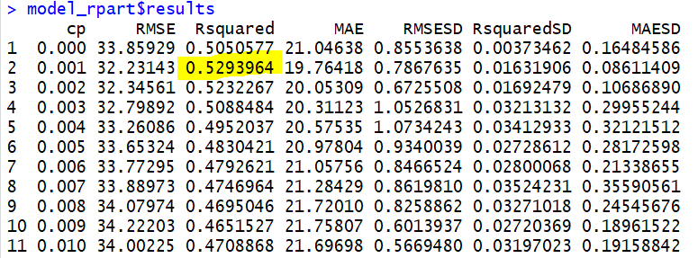
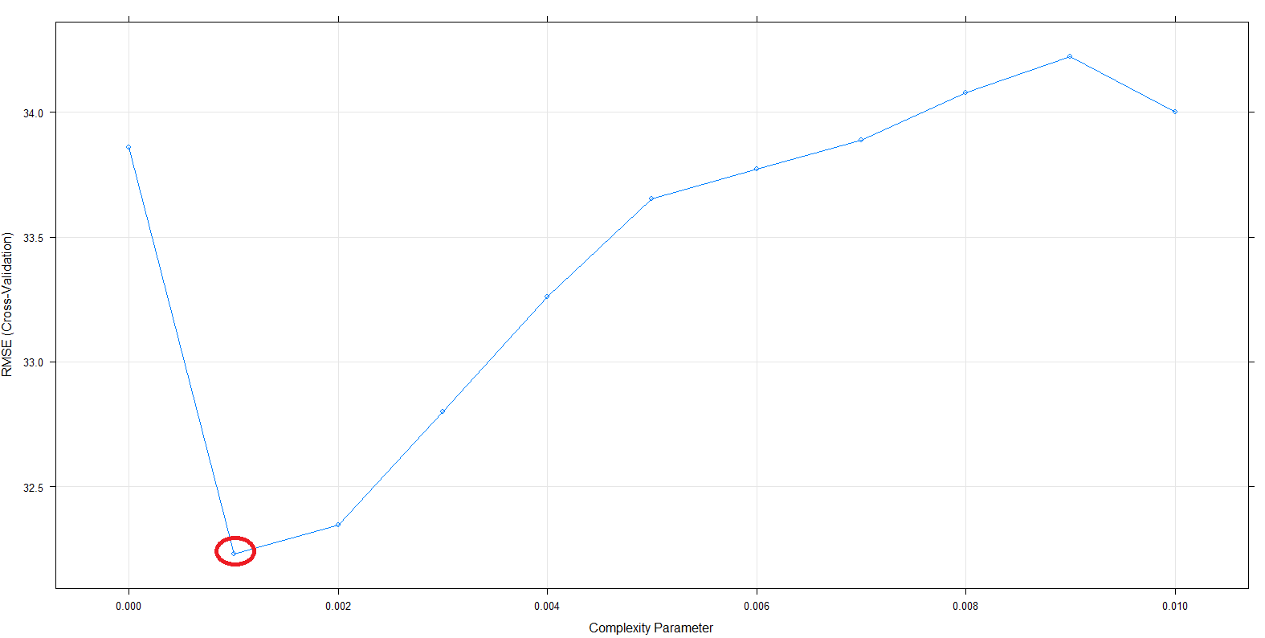
Data Modelling
DECISION TREE
RMSE (Cross-Validation)
Complexity Parameter
Included the significant interaction terms coming from regression as independent variables for all the non linear model creation
Key Points:
Decision trees have done a better job at capturing the non-linearity in the data by dividing the space into smaller sub-spaces
RMSE and Rsquare value to asses model accuracy for different tuning values which in case of tree is the complexity parameter cp are shown above
20

Slide 21
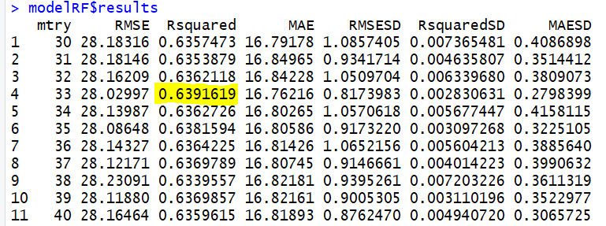
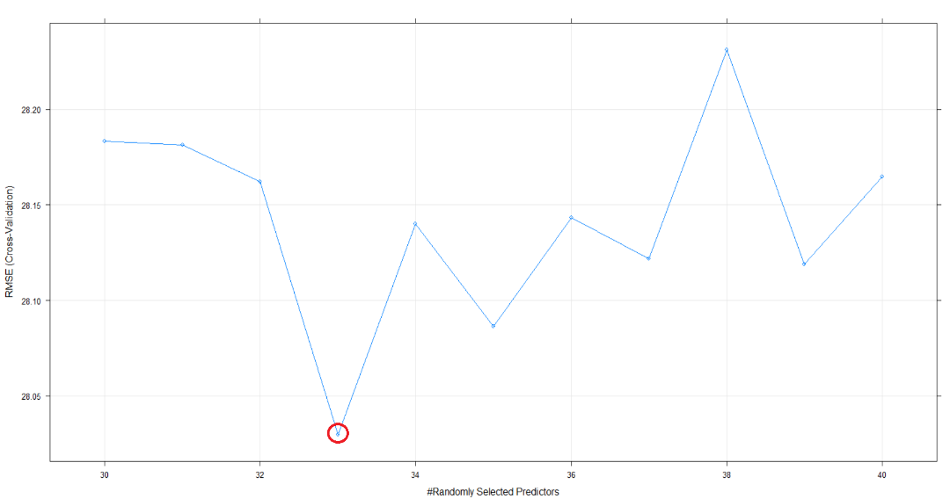
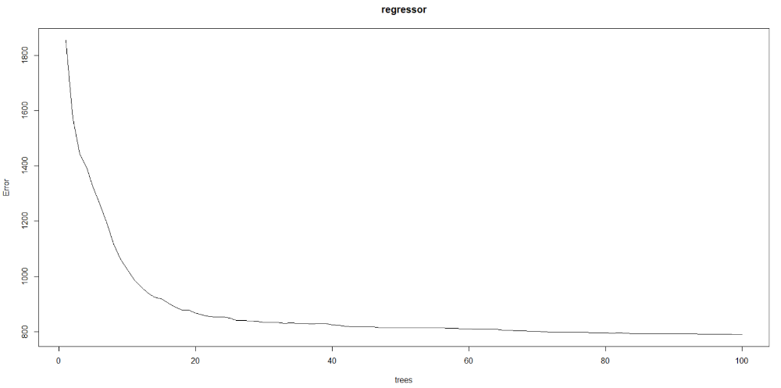
Data Modelling
RANDOM FOREST
RMSE (Cross-Validation)
#Randomly Selected Predictors
Regressor
Key Points:
The tuning parameter is mtry which is number of predictors available at each split
Rsquare value has improved significantly in case of random forest as it is the aggregation of multiple trees and finally takes mean of the sub sections of all the trees
trees
21

Slide 22
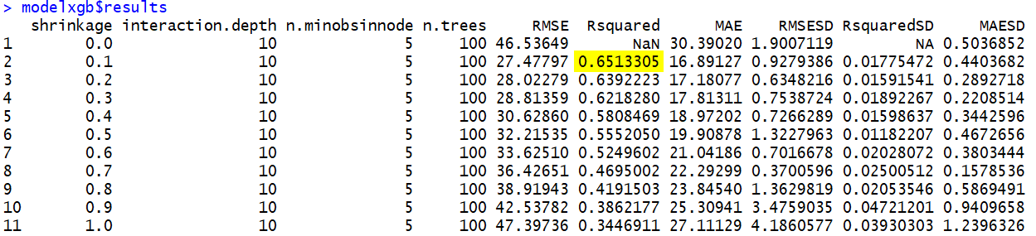
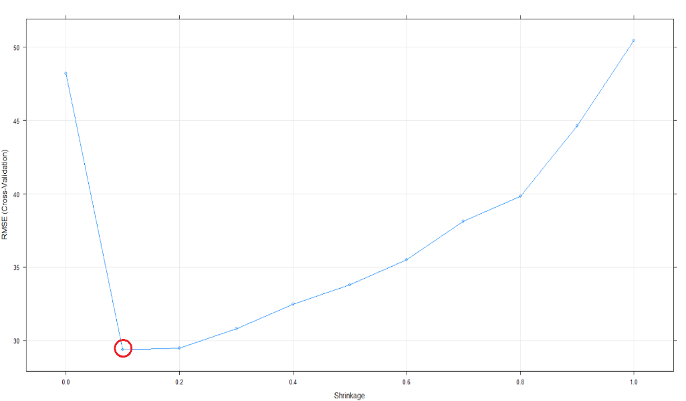
Data Modelling
BOOSTED TREE
RMSE (Cross-Validation)
Shrinkage
Key Points:
Created multiple 100 trees model in which trees are grown in an sequential manner by varying the learning rate (lambda)
The optimum model is coming at lambda = 0.1
The performance of the boosted tree is slightly better than Random Forest
22

Slide 23
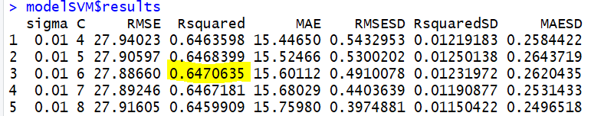
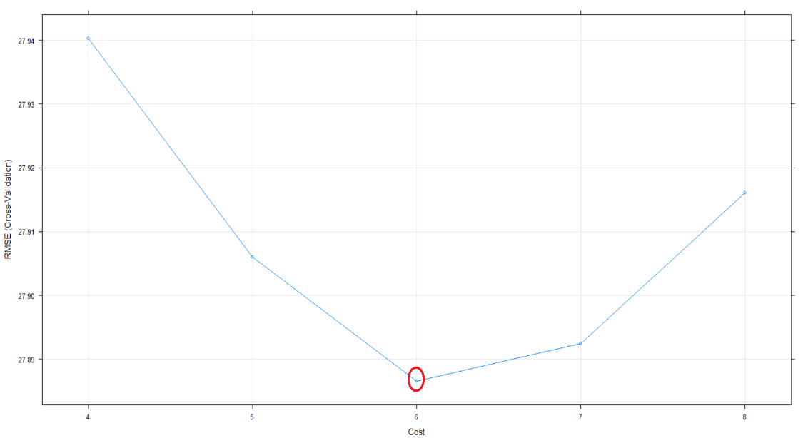
Data Modelling
SUPPORT VECTOR MACHINE
RMSE (Cross-Validation)
Cost
Key Points:
Used the Radial basis function as kernel
The optimum model is coming at cost function equal to 6, which T and smoothing parameter (sigma) of 0.01
23

Slide 24
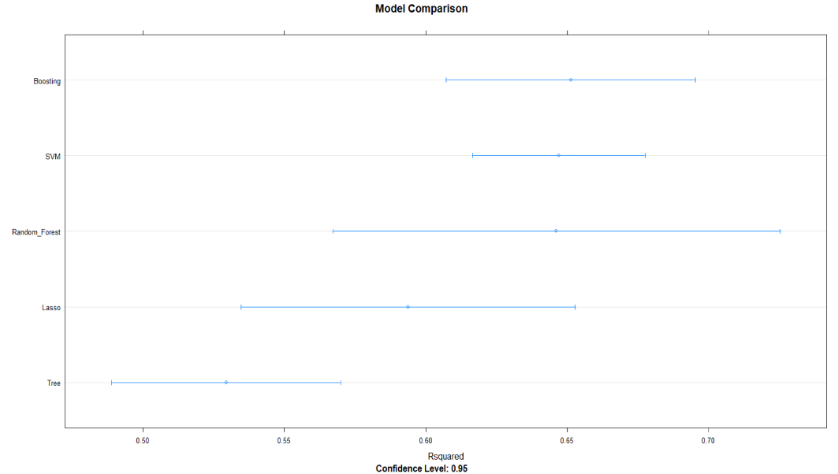
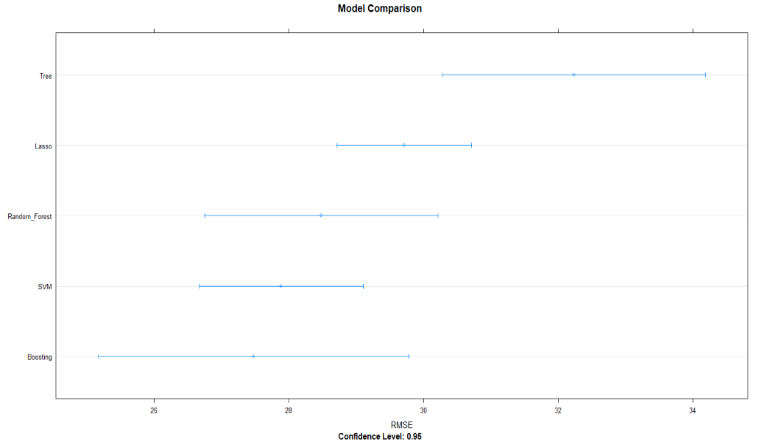
Data Modelling
Model Comparison
Model Comparison
MODEL COMPARISON
Rsquared Confidence Level: 0.95
RMSE Confidence Level: 0.95
Key Points:
Random Forest and Boosted tree are coming as the best models
The maximum R square for the dataset using different models is coming to be ~65%
Model | R Squared (Test Set)
Linear Regression | ~42%
LASSO | ~61%
Decision Tree | ~54%
Random Forest | ~65.5%
Boosting | ~64.5%
SVM | ~63%
24

Slide 25
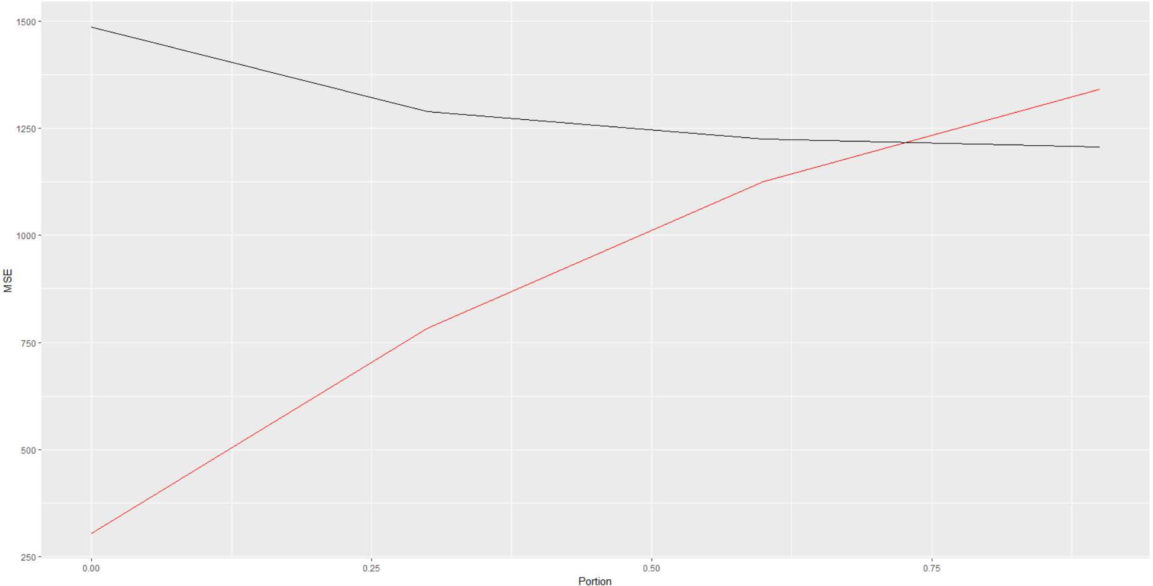
Data Modelling
Learning Curve
Key Points:
The training set error (RMSE) will keep increasing as the training set size increases
The test set error decreases till ~70% portion of the data. The rest 30% of the training data is redundant as it is not helping the model in improving the accuracy
25

Slide 26
Agenda
Problem Statement
Data Availability (Data Set & Inputs)
Exploratory Data Analysis
Data Pre-Processing
Data Modelling
Insights
Enhancements

Slide 27
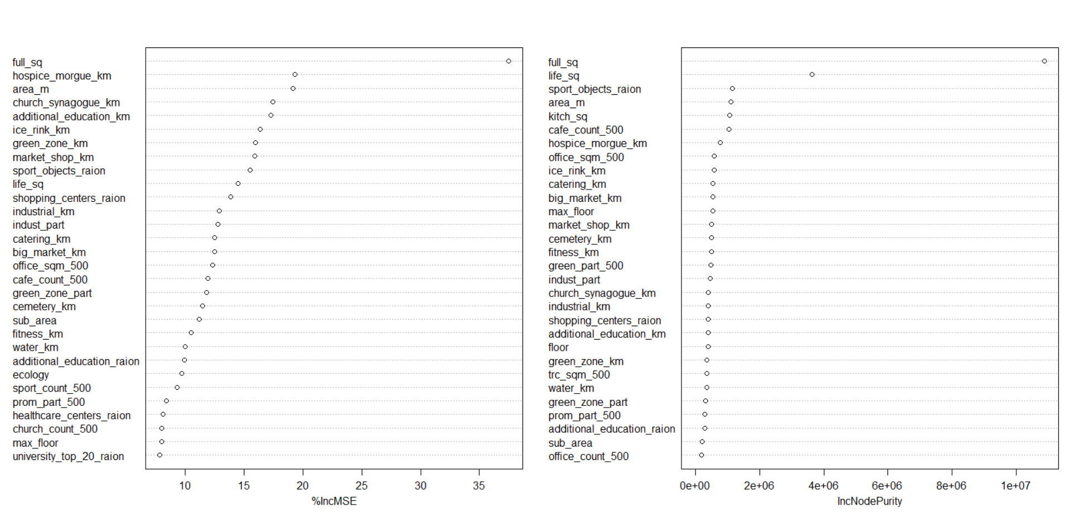
IMPORTANCE OF PREDICTING HOUSING PRICES
Insights
VARIABLE IMPORTANCE
Key Points:
Variables which were expected and also important include Full area, market distance, ecology rating , green zone distance etc.
Unexpected variables which are important include distance to Hospice, church, cemetery, number of cafes around etc.
27

Slide 28
IMPORTANCE OF PREDICTING HOUSING PRICES
Insights
Housing Prices
Banking Loan
Credit Cycle
Mortgage Pricing
28

Slide 29
GRANT HOUSING LOANS TO CUSTOMERS CTING HOUSING PRICES
Model Applications
Customer Approaches the Bank
Bank Employs Information Credibility Check
Collects Additional Parameters
Model is Run on the Available Parameters
Accurate Price Prediction of the House
29

Slide 30
HOUSING MORTGAGES
Model Applications
Customer Approaches the Bank to Mortgage a Property
Bank Employs Information Credibility Check
Collects Additional Parameters
Model is Run on the Available Parameters
Accurate Price Prediction of the House
New Housing Loan
Business Loan/Personal Loan etc.
30

Slide 31
What Next ?
Sberbank’s Decision Factors
Maximum Amount of Loan
80% of the Housing Price
70% of the Housing Price
Percentage of Interest
Payback Period
60% of the Housing Price
31

Slide 32
Agenda
Problem Statement
Data Availability (Data Set & Inputs)
Exploratory Data Analysis
Data Pre-Processing
Data Modelling
Insights
Enhancements

Slide 33
Enhancements
Macro-economic Factors
Historical Data – House Pricing Trends
Access To Higher Configuration Systems
Continuous Learning Model
33

Slide 34
Q & A

